Slide 1
Quantum Computing Architectures (EE274) Lecture 1
Hiu-Yung Wong
Jan. 23, 2025
hiuyung.wong@sjsu.edu, Office: ENG363
http://www.sjsu.edu/people/hiuyung.wong/index.html

Slide 2
Outline
Introduction
Class Information and Logistics
Introduction to Quantum Information

Slide 3
Introduction to Quantum Information

Slide 4
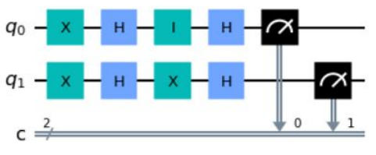
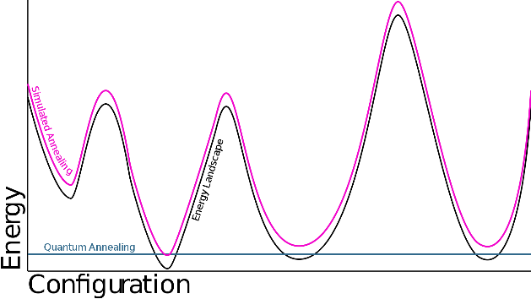
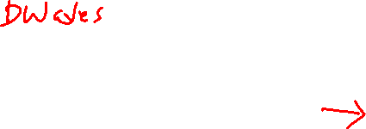
Applications of Quantum Computing
Quantum computing uses two quantum phenomena
Superposition and entanglement and interference
Two major types of quantum computing
Gate-based (this talk)
Quantum annealing (optimization by minimizing energy)
Applications
Material and drug design
Secure communication
Optimization
Finance
Gate Model
Quantum Annealing

Slide 5
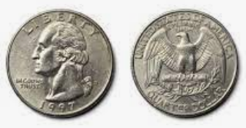
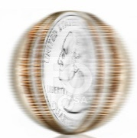



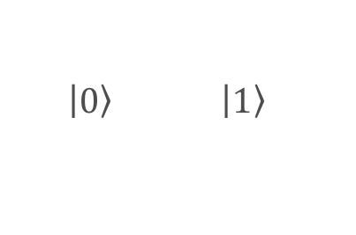
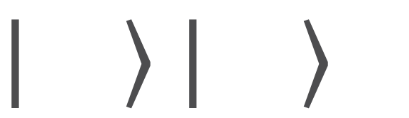
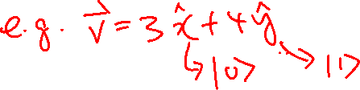


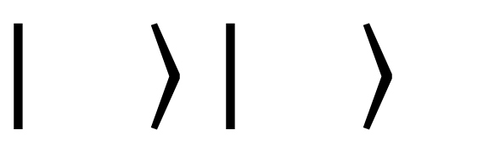

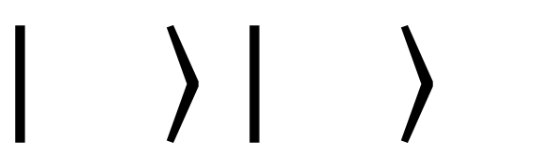
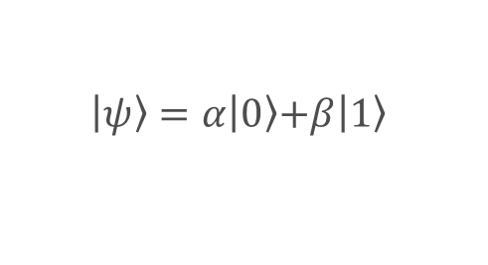
State and Superposition
Classical Computing
Quantum Computing
(basis states)
Quantum Computing with superposition
$$0$$
$$1$$
$\left.\left|0\right.\right\rangle$ $\left.\left|1\right.\right\rangle$
$$\left.\left|ψ\right.\right\rangle =\left.α\left|0\right.\right\rangle \left.+β\left|1\right.\right\rangle$$
$$\left.\left|\right.\right\rangle =α\left.\left|\right.\right\rangle +β\left.\left|\right.\right\rangle$$
Information represented by the states
Quantum computing is powerful because it uses superposition
No difference from classical computing

Slide 6
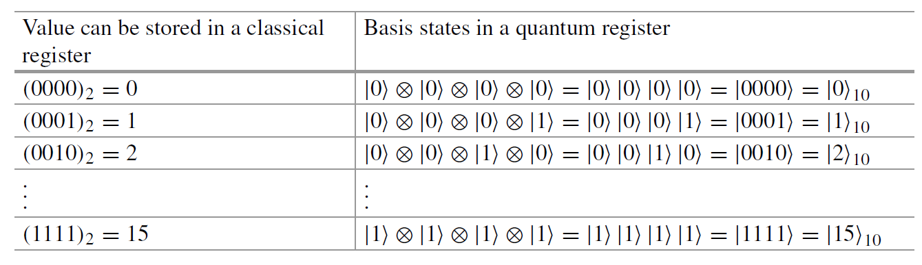
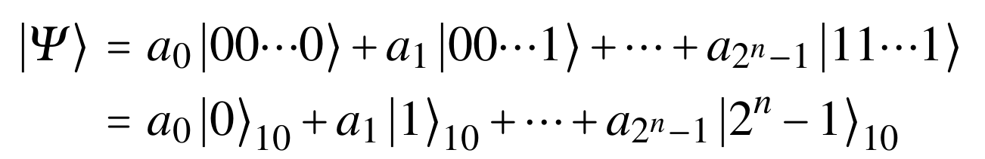
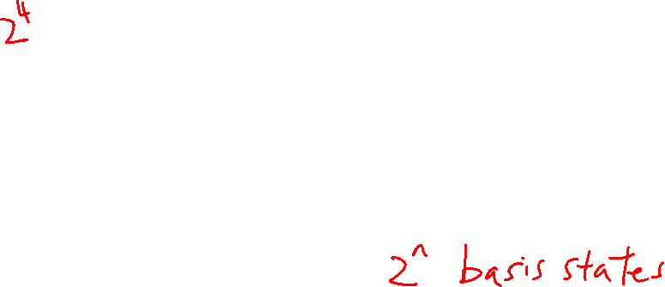
Quantum Registers
Superposition of basis states of multiple qubits

Slide 7
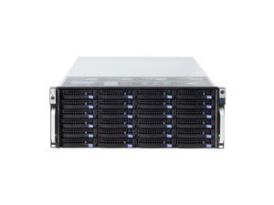
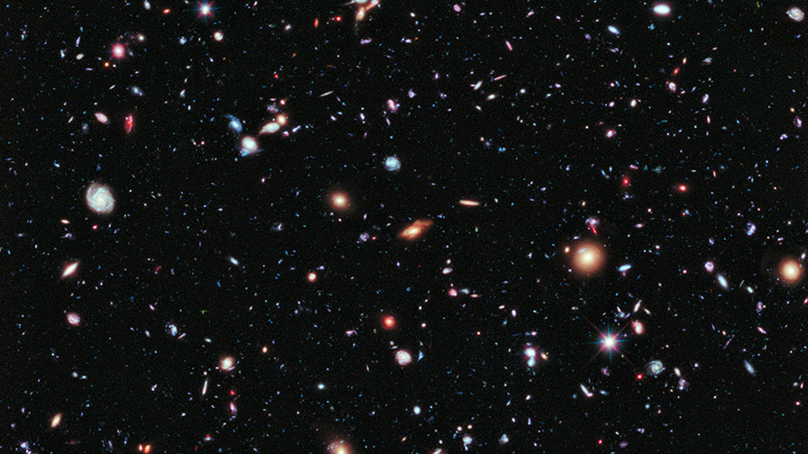
The Power of Superposition
n = 300 (e.g. electrons)
2³⁰⁰ = 10⁹⁰ complex coefficients, a_{i}
Number of atoms in the universe < 10⁸²
Total number of storage in the world < 10²¹ bytes

Slide 8
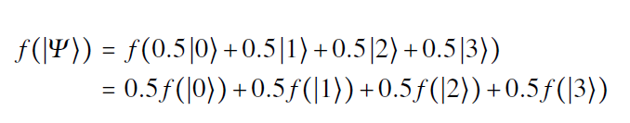
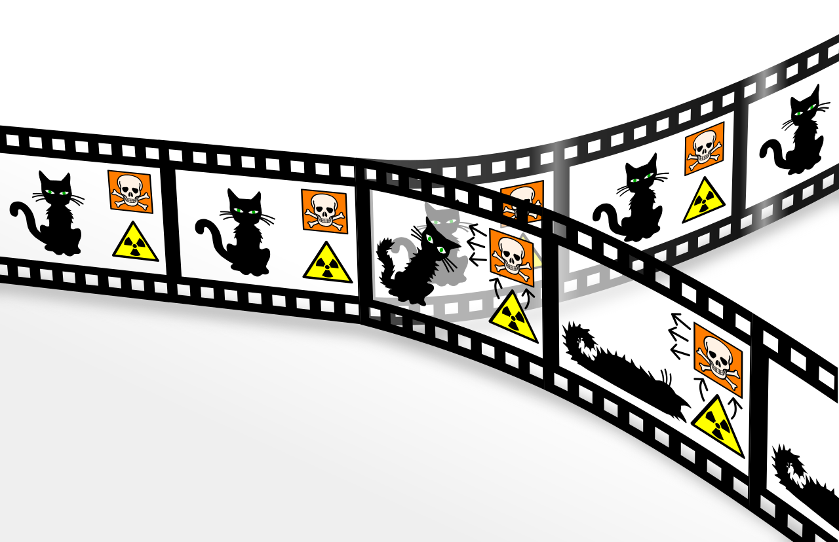


Quantum Parallelism
Linear Quantum mechanics
Wikipedia

Slide 9
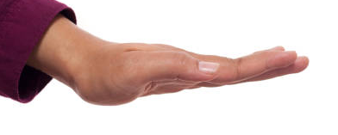









Measurement
$${\left|α\right|}^{2}$$
$$\left.\left|0\right.\right\rangle$$
$$\left.\left|ψ\right.\right\rangle =\left.α\left|0\right.\right\rangle \left.+β\left|1\right.\right\rangle$$
M
$$\left.\left|1\right.\right\rangle$$
$${\left|β\right|}^{2}$$

Slide 10
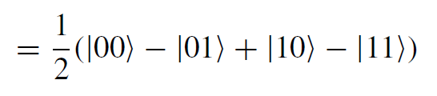
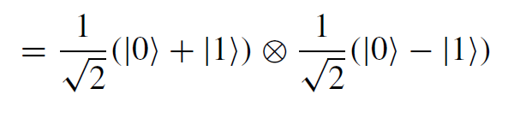

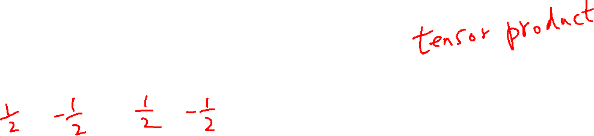
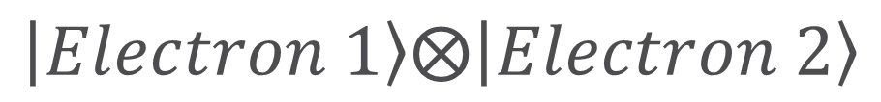
Entangled States
Unentangled State
Electron 1
Electron 2
Entangled State: Used in quantum computing algorithms and also quantum communications
$$\left.\left|Electron 1\right.\right\rangle ⨂\left.\left|Electron 2\right.\right\rangle$$

Slide 11
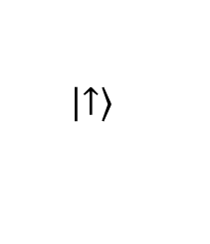

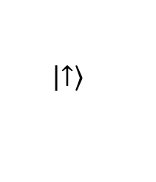

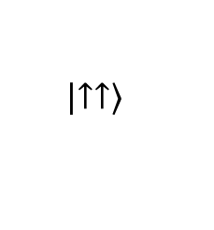

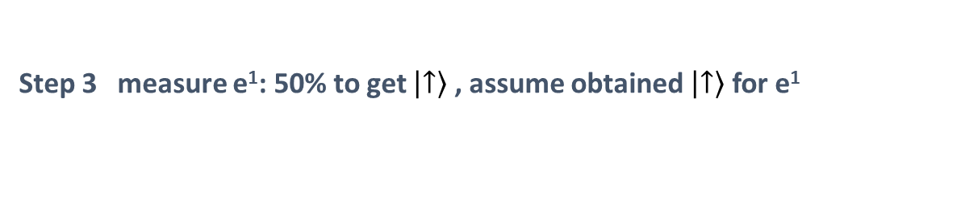
Quantum Entanglement – Spooky Action
$$Φ^{+}=\frac{1}{\sqrt{2}}\left(\left.\left|↑↑\right.\right\rangle +\left.\left|↓↓\right.\right\rangle \right)$$
Step 1
e¹
e²
Step 2
Earth
$$Φ^{+}=\frac{1}{\sqrt{2}}\left(\left.\left|↑↑\right.\right\rangle +\left.\left|↓↓\right.\right\rangle \right)$$
100 light years away
e¹
still entangled
e²
Step 3 measure e¹: 50% to get $\left.\left|↑\right.\right\rangle$ , assume obtained $\left.\left|↑\right.\right\rangle$ for e¹
collapse
$$Φ^{+}$$
$$\left.\left|↑↑\right.\right\rangle$$
$$\left.\left|↑\right.\right\rangle$$
Earth
100 light years away
$$\left.\left|↑\right.\right\rangle$$
e¹
e²

Slide 12

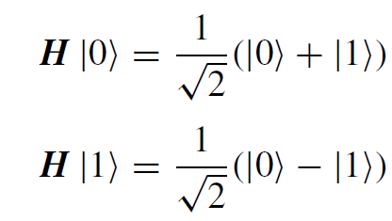



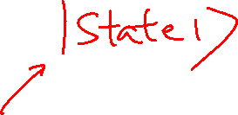



Quantum Gates
Bloch Sphere
$$\left|\left.0\right\rangle \right.$$
Quantum gates rotate the vector (state) in the corresponding hyperspace
Very often, a gate is just a laser or microwave pulse
Some gates have classical counterparts
NOT gate (1-qubit)
CNOT gate (2-qubit)
Some gates have no classical counterparts
Hadamard gate
$$\left|\left.Ψ\right\rangle \right.$$
θ
$$\left|\left.−\right\rangle \right.$$
$$φ$$
$$\left|\left.+\right\rangle \right.$$
$$\left|\left.1\right\rangle \right.$$
We embed the hyperspace of a qubit in our real 3D space

Slide 13
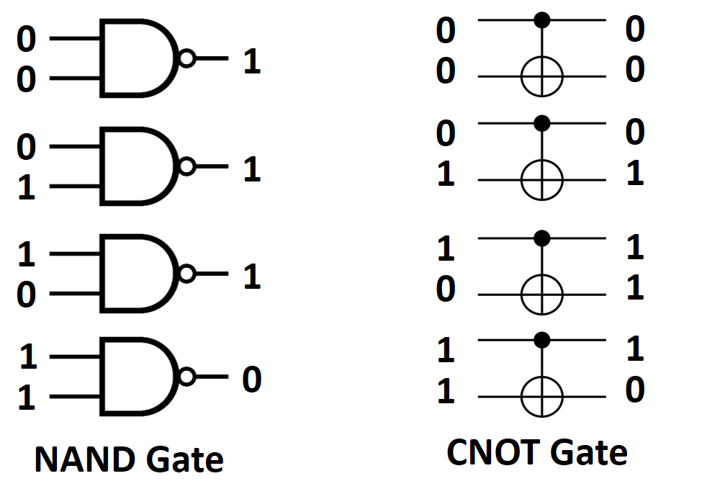
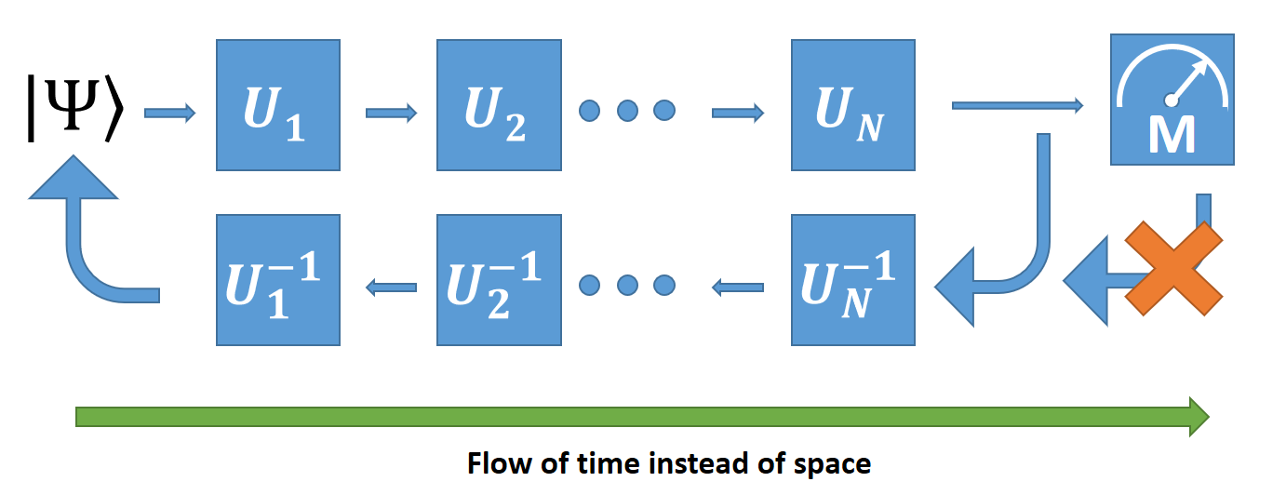
Quantum Gates and Circuits
Quantum gates must be reversible
Quantum circuit is the application of operations (microwave/laser pulses) to usually stationary qubit carriers.

